Slide 1
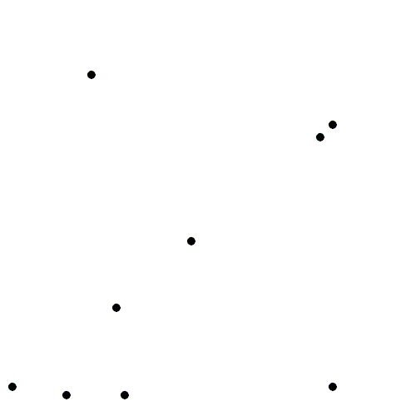

Voronoi Diagrams, Medial Axis &
Straight Skeleton
By Debraj Das, Sahil Baranwal, Joyoshish Saha

Slide 2
Voronoi Diagram

Slide 3
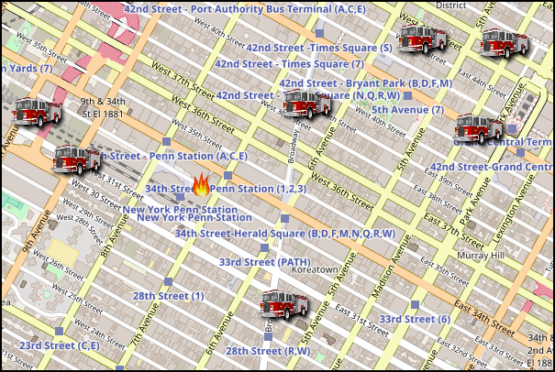
Imagine a city, where a fire is declared. Emergency services need to send a fire truck to this place. If there are N fire stations, what fire truck should be sent?

Slide 4
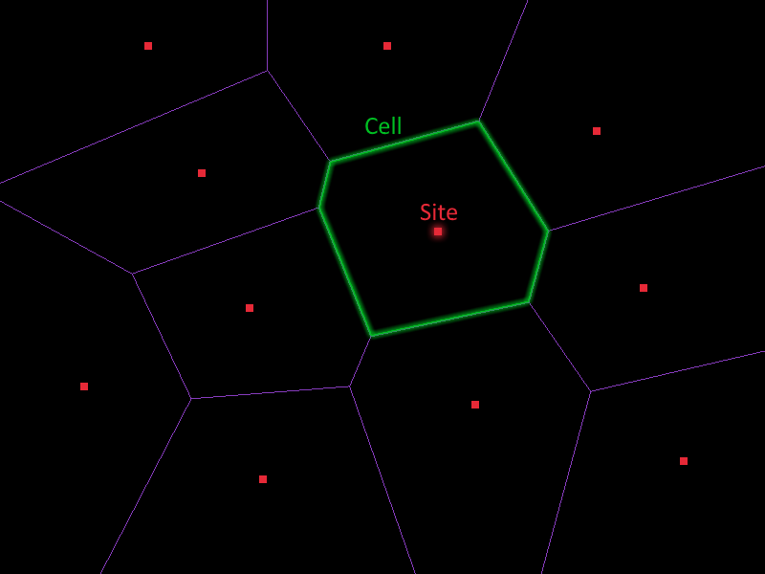
Voronoi Diagram:
Partitioning of a plane with n sites into convex polygonal cells such that each cell contains exactly one site and every point inside this cell is closer to its site than any other.

Slide 5
The Voronoi region Vor(p) of a site p in S is
Vor(p) = {x ∈ R2 | ∥x − p∥ ≤ ∥x − q∥ for all sites q in S},
where ∥p − q∥ denotes the (Euclidean) distance between points p and q in the plane.

Slide 6
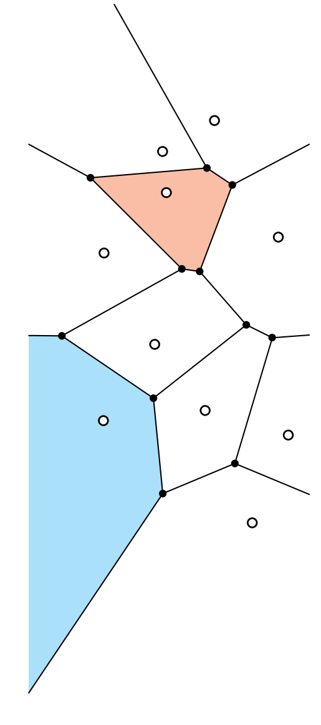
Bounded and Unbounded
Convex Voronoi Regions
Points on boundary don’t have unique nearest site
Intersection of all halfplanes

Slide 7

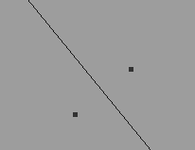
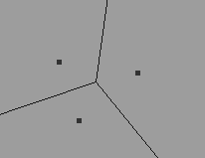
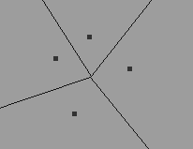
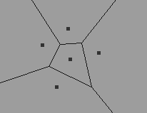
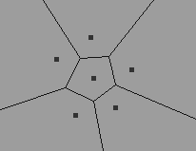
The Voronoi diagrams can be computed by an incremental construction.

Slide 8
Interesting Application
Autonomous Drone:
The safest trajectory for flying can be the path along the cell boundaries of voronoi diagram, where sites are the static or dynamic obstacles.
Machine Learning:
In machine learning, Voronoi diagrams are used to do 1-NN classifications.

Slide 9
Medial Axis

Slide 10
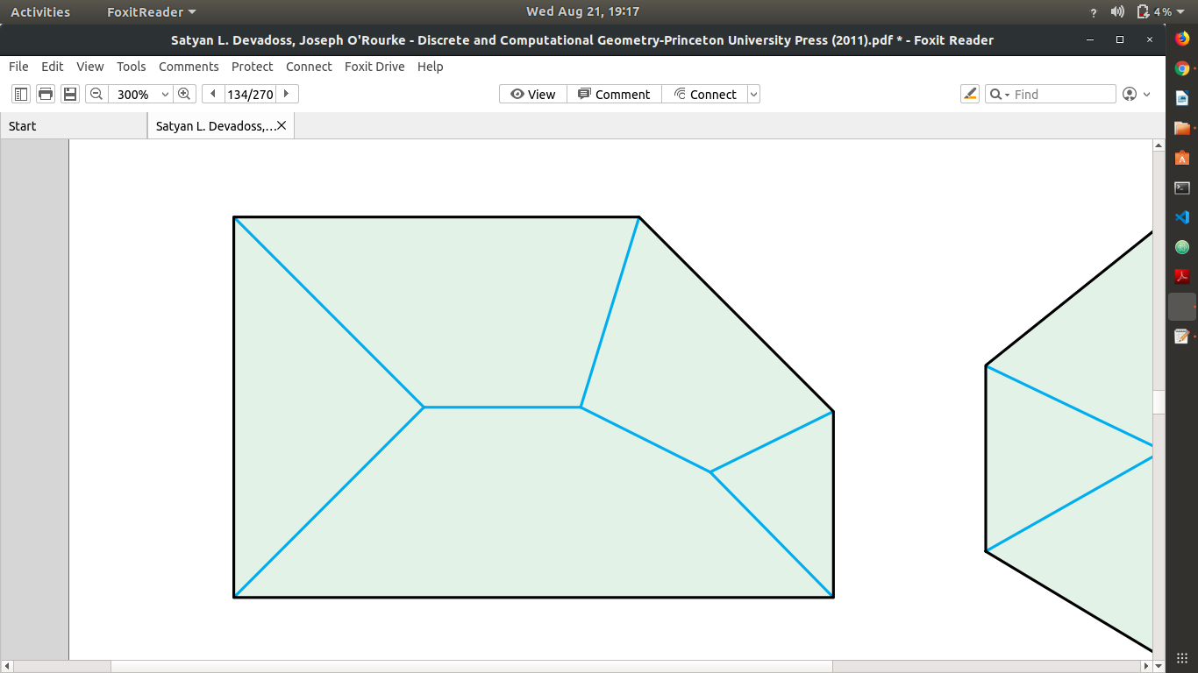
The medial axis M(P) of a polygon P is the closure of the set of points in P that have two or
more closest points among the points of ∂P.

Slide 11
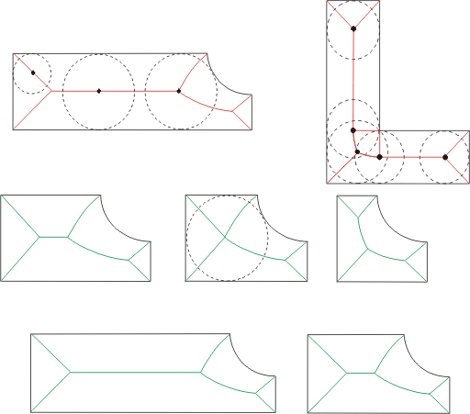
The Medial axis is the locus of the centers of circles that are tangent to the polygon at two or more points.

Slide 12
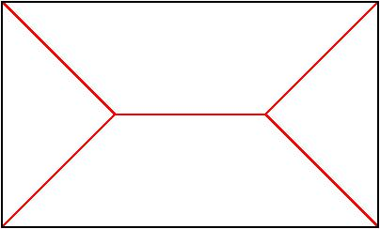
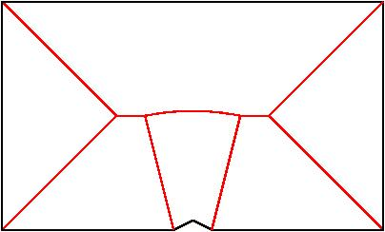
The Medial Axis comprises straight lines if the polygon is convex.
If the object is concave, every reflex vertex induces a curved edge.

Slide 13
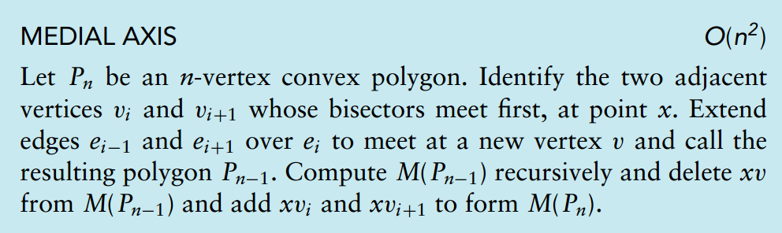
Medial Axis Construction

Slide 14
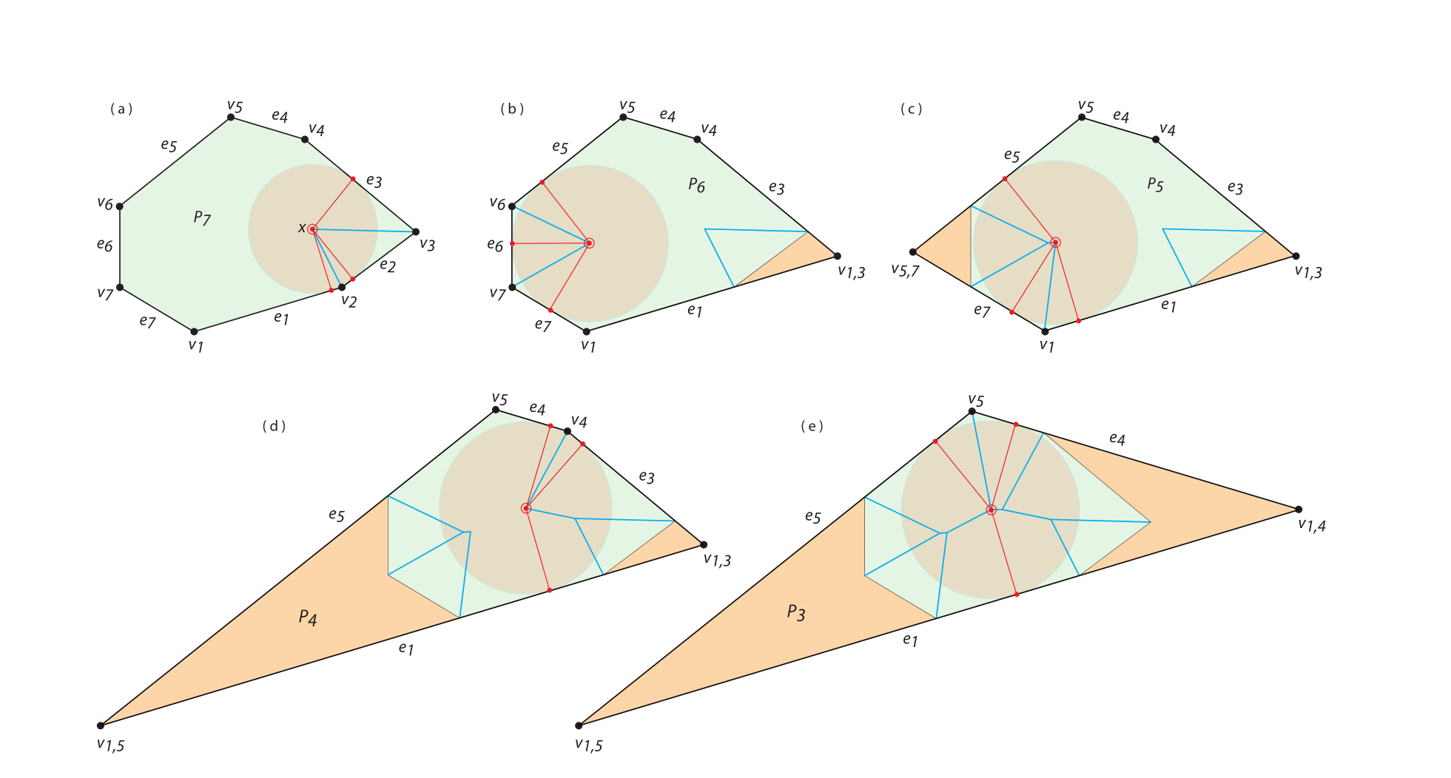

Slide 15
Straight Skeleton

Slide 16
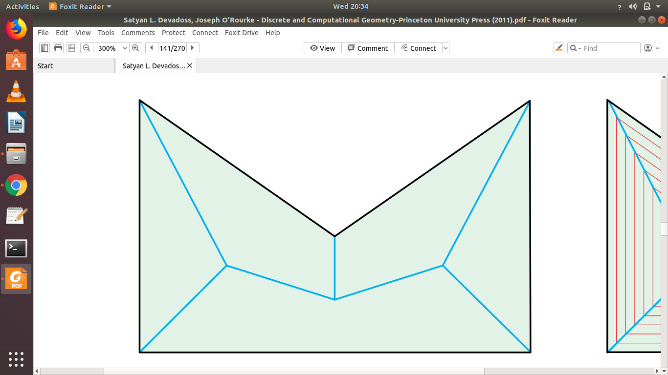
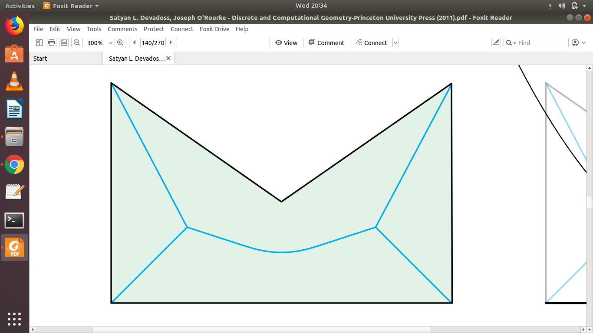
The Straight Skeleton is a linear approximation of the Medial Axis.
Medial Axis Straight Skeleton

Slide 17
For a convex polygon, the straight skeleton is identical to the medial axis, but for nonconvex polygons, the straight skeleton has no parabolic arcs.
Unlike the medial axis, the straight skeleton is not a Voronoi diagram in any sense.

Slide 18
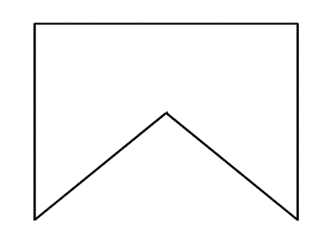
Straight skeleton can be formed with the trace of the angular bisectors of the vertices, as the edges of the polygon are propagating at equal rate, until the polygon vanishes.

Slide 19
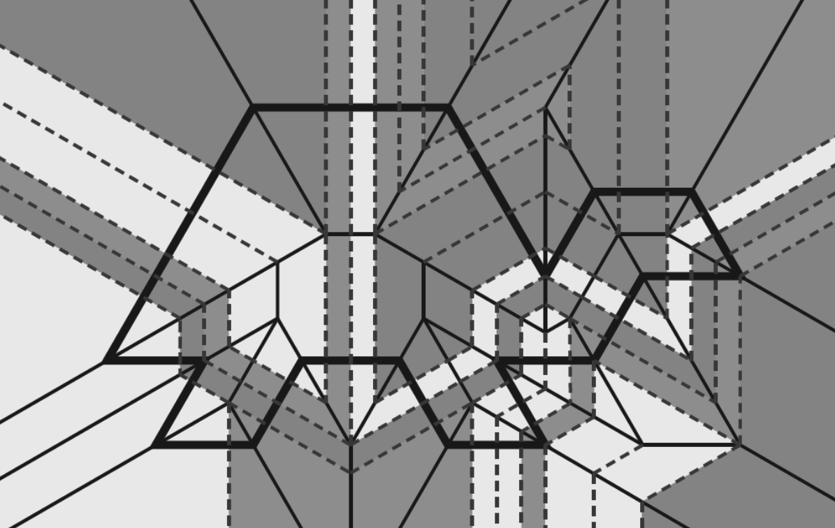
Fold-and-one-Cut
Fold flat
Make one complete
straight cut
Unfold
What shapes of cuts are possible?
Can be solved by Straight Skeleton

Slide 20
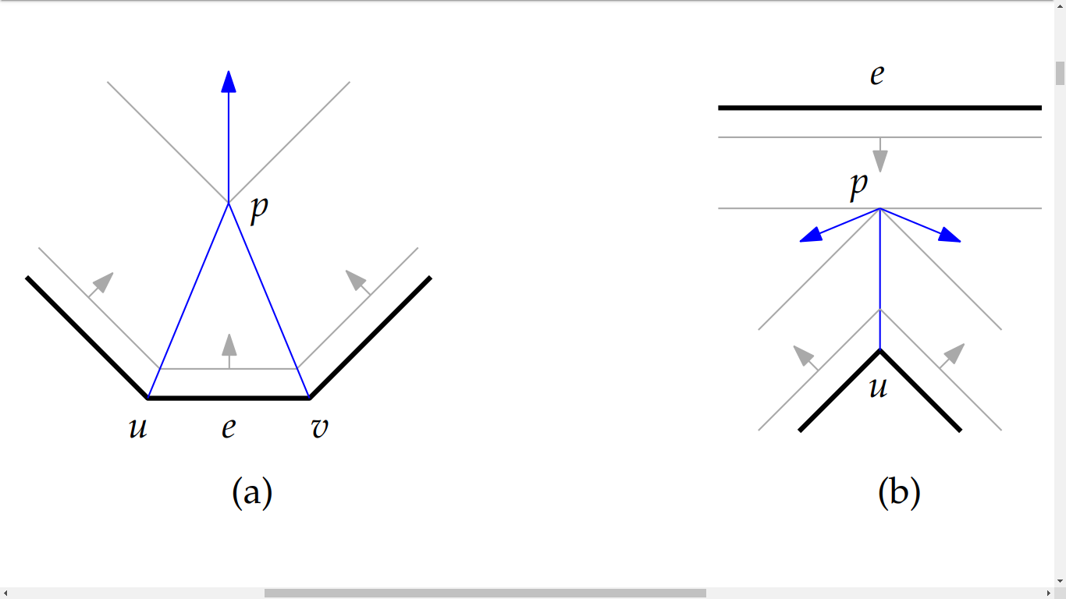
Two possible events may occur during the propagation:
Edge event: Portion of an edge vanishes.
Split event: A reflex vertex hits an opposite edge, splitting the polygon into two disconnected parts.
The edges stop propagating when one of these events occur.

Slide 21
Straight Skeleton Computation
Successfully used by Oliva et al as a part of a system for three dimensional reconstruction of objects from a given set of 2D contours in parallel cross sections.
Felkel & Obdrzálek offered a straightforward event-based algorithm which applies the principle of the roof construction by sweep algorithm and that simulates cutting of the roof by parallel planes and checks local changes of the polygonal base in the cross sections.

Slide 22
Data Structure required for the algorithm:
A set of circular lists of active vertices (SLAV).
Stores a loop of vertices for outer boundary and for all holes and sub-polygons created during the straight skeleton computation.
In the case of convex polygon, it always contains only one list (LAV).
In the case of a simple non-convex polygon, it stores a list for every sub-polygon and in the case of polygons with holes also a list for each hole.

Slide 23
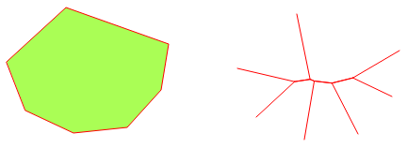
Convex Polygon Skeleton Computation
Only edge event occurs.
The polygon vertices and edges are oriented anticlockwise and the polygon interior is on the left-hand side of its boundary.
Convex Polygon
Skeleton

Slide 24
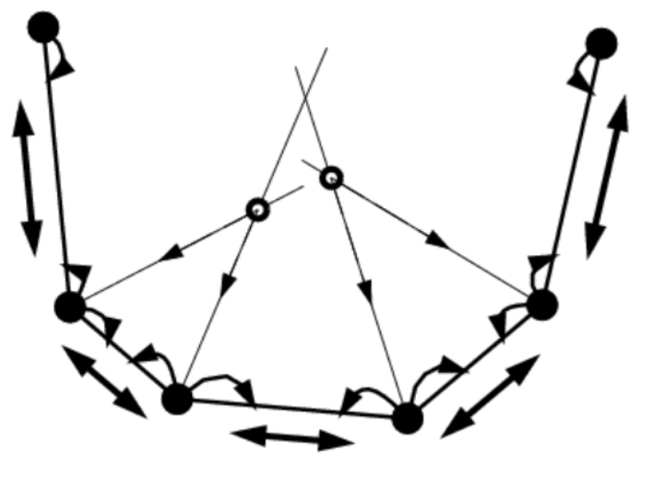
Initialization
Create a LAV for the polygon – a circular list of its vertices by order.
Add pointers for the edges between vertices.
Compute a bisector per vertex.
All vertices are marked “unused”.
Compute the intersection point of every set of adjacent bisectors – this point is the location of the edge event between them.
Queue the edge event (marked EDGE_EVENT)
in a priority queue according to the distance of the
Intersection from the line supporting the edge.

Slide 25
Propagation
While the events queue != empty do
If next event uses used vertices, discard event.
Else, handle edge event ;
If LAV contains 3 edges, create new vertex at the intersection, and skeletal edges from each of the 3 vertices.
If LAV contains more than 3 edges,
Create two edges of the skeleton, each from one of the event vertices to the location of the event (the intersection point).
Remove these two vertices from the LAV, and mark them as “used”.
Create a new vertex, located at the intersection point, and put it in its place in the LAV, pointing to its adjacent edges.
Compute new edge events for the vertices of these adjacent edges.

Slide 26
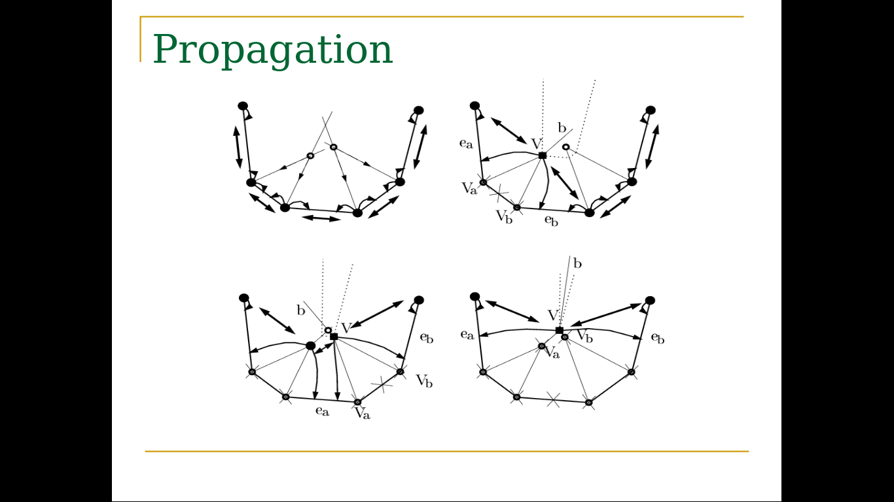
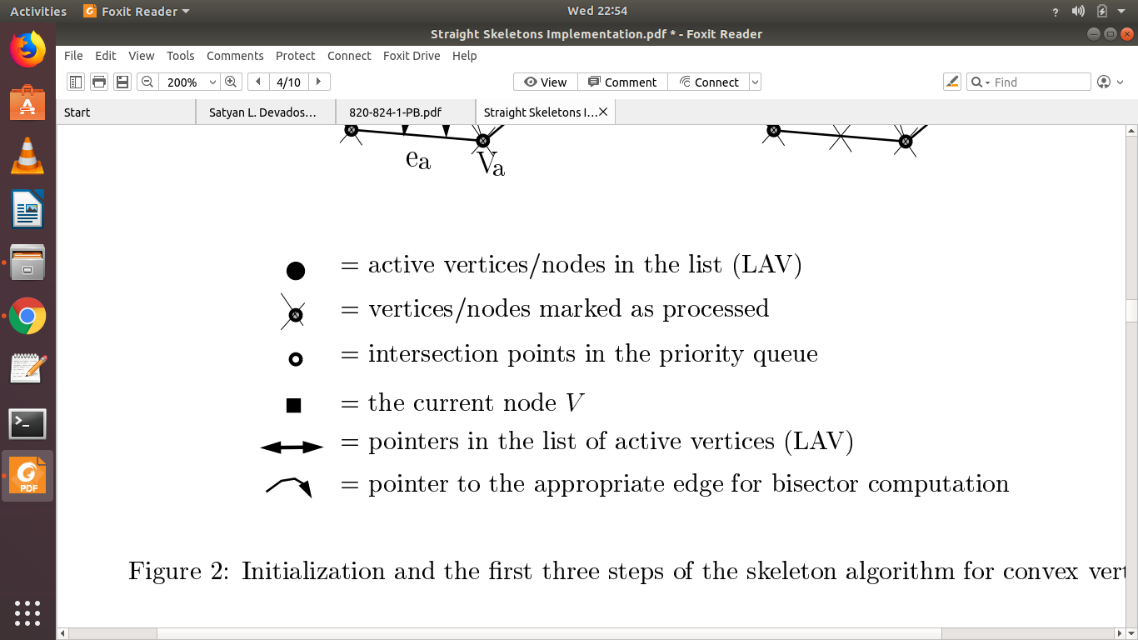

Slide 27
Complexity
O(nlogn), for maintaining the events queue. Every event handling is O(1).
The most time-efficient algorithm known has time complexity O(n^{1 + ε} + n^{8/11 + ε}r^{9/11 + ε}).

Slide 28
Non Convex Polygon Skeleton Computation
An extension of the convex algorithm.
We have to find out when split events occur.
Another step in initialization:
Determine all possibilities of a reflex vertex hitting an opposite edge.
Queue these events as SPLIT_EVENT.

Slide 29
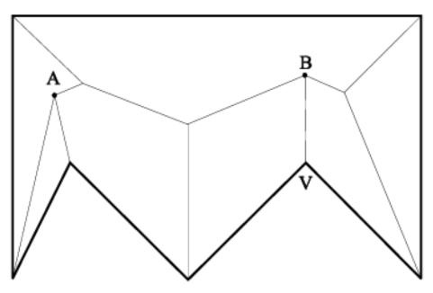
Obtaining Split Events
A splitting location B is equidistant from the lines supporting the edges adjacent to the reflex vertex, and from the line supporting the opposite edge.
For every reflex vertex, we traverse all of the edges in the polygon and test for intersection.
A simple intersection test between the bisector of the reflex vertex and the opposite edge isn’t enough.
The intersection point between the reflex vertex and the line supporting the opposite edges must be in the area defined between the edge and the bisectors of its two vertices.
The intersection point is the meeting point of the three bisectors between all three participating edges (the two defining the reflex vertex and the split edge).
Not all reflex vertices eventually cause split events. (A is an edge event, and B is a split event).

Slide 30
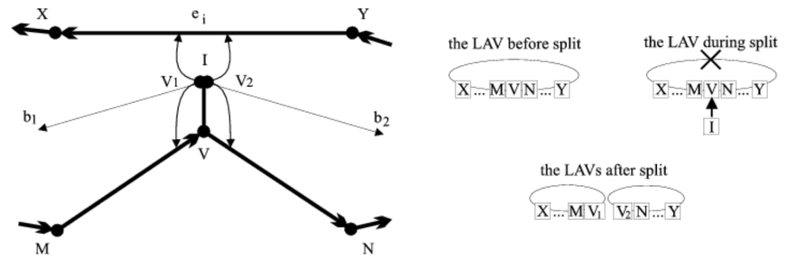
Handling Split Events
When a split event occurs, the polygon splits into two parts.
The LAV in context is split into two LAVs as well.

Slide 31
Handling Split Events – Cont’d
The splitting vertex is replaced with two new vertices, each in the appropriate place in a different LAV.
New bisectors and edge events are calculated for each of these vertices.

Slide 32
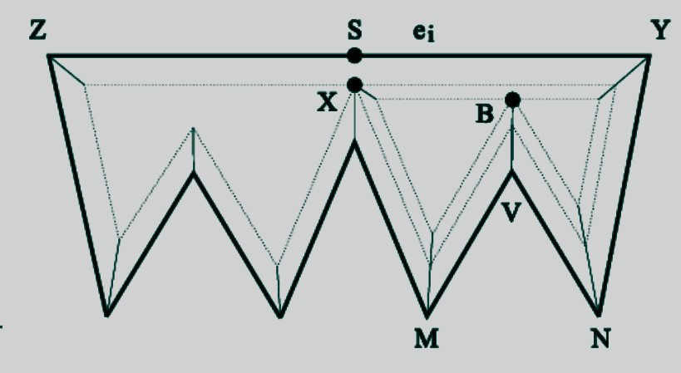
Handling Multiple Splitting
An edge can be split several time.
Any split event handling must realize what part of the edge it is splitting (i.e. what are the proper endpoints).
It is done by traversing the LAV in context at each handling of a split event.

Slide 33
Initialization
Create one LAV.
Compute bisectors.
Compute split and edge events.
Queue all events according to time (distance).

Slide 34
Propagation
While event queue has events,
If new event contains used vertices, discard event.
If event is edge event, handle as in the convex case.
Mark vertices as “used”. If the LAV in context contains 3
vertices, close up the skeleton.
If event is split event, split the LAV into two, and
maintain pointers accordingly. Mark the splitting vertex
as “used”.
In the end, there are no LAVs left!

Slide 35
Complexity
The total complexity is O(rn+nlogn)
n = # vertices
r = # reflex vertices

Slide 36
Applications of Straight Skeleton

Slide 37
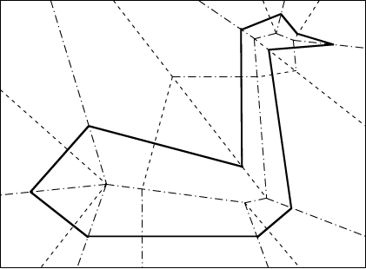
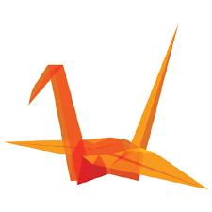
Origami:
Prototype of a model.
Folding paper that makes the skeleton of a 3d figure.

Slide 38
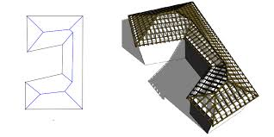
Rooftop:
Rooftop can be designed by the concept of straight skeleton of varied 2d polygon.
2d skeleton can be lifted into 3d space.

Slide 39
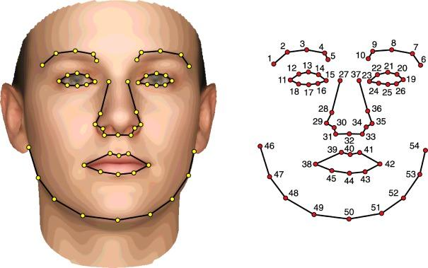
Image processing:
Tănase and Veltkamp propose to decompose concave polygons into unions of convex regions using straight skeletons, as a preprocessing step for shape matching in image processing.

Slide 40
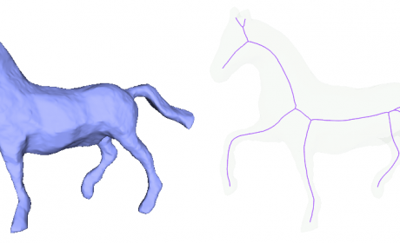
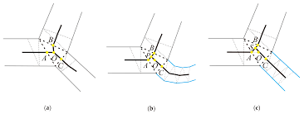
GIS:
Can be used to collapse a two-dimensional area to a simplified one-dimensional representation of the area.
Haunert and Sester describe an application of this type for straight skeletons in geographic information systems, in finding the centerlines of roads

Slide 41
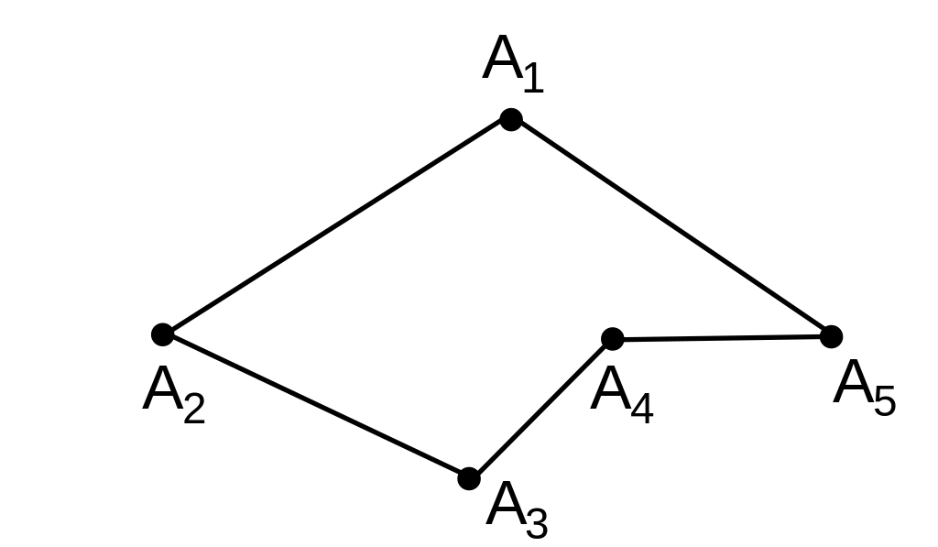
Polygonal Chains:
Barequet et al. use straight skeletons in an algorithm for finding a three-dimensional surface that interpolates between two given polygonal chains.
A closed polygonal chain

Slide 42
These resources helped us:
Discrete and Computational Geometry by Satyan L. Devadoss and Joseph O’Rourke
Google Images
Wikipedia
http://jeffe.cs.illinois.edu/open/skeleton.html
https://pdfs.semanticscholar.org/cc72/31fa261790e762abb3dacf19f5858a1eb3a9.pdf
http://www.inf.u-szeged.hu/~palagyi/skel/skel.html#Voronoi

